Slide 1

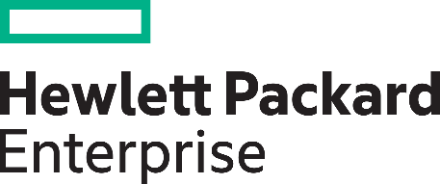
innovation - operations
approaches to solving the budget dilemma

Slide 2



Speaker
Stefan Denninger, ACP P-CSA, Microsoft RD Community Lead ExpertsLiveAT
Cyrill Eigensatz, HPE Alliance Manager

Slide 3
dilemma
„a situation in which one needs to choose between two unpleasant things“

Slide 4

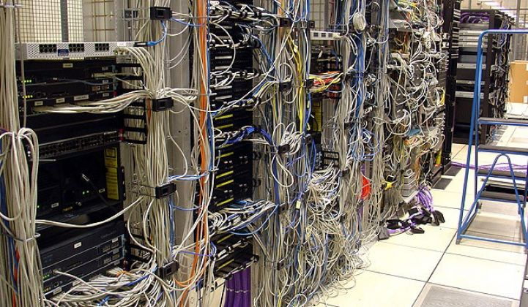
innovation vs. operations

Slide 5
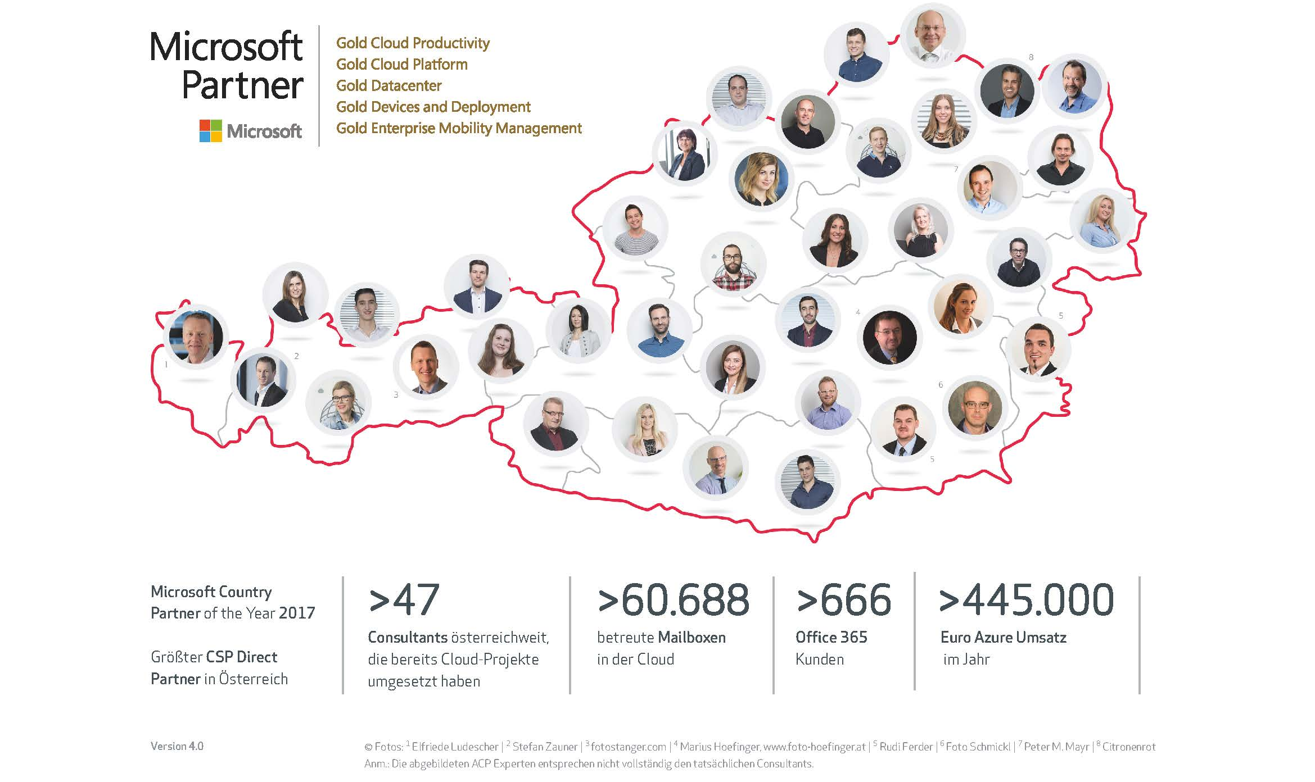
ACP Team

Slide 6
ACP public cloud offerings
Azure Cloud Strategie
Azure Onboarding Ramp Up Phase
Azure PoC Testaufbau (T & S)
Azure Governance Costcontrol, Policies
Hybrid Identity Hosted ADFS
Azure Operations (T & S)

Slide 7
cloud
on-demand resources – self-service
broad network access – perfect connectivity
resource pooling – shared
rapid elasticity – scale
measured service – pay per use

Slide 8
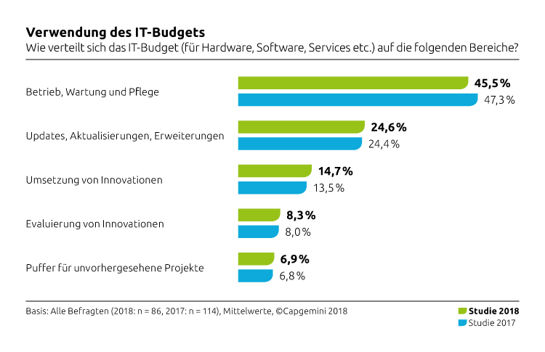
innovation vs. operations
70% for running
CapGemini Studie, IT-Budgets 22.2.2018
https://www.capgemini.com/de-de/article/it-budgets/

Slide 9
How can we redirect resources towards innovation

Slide 10
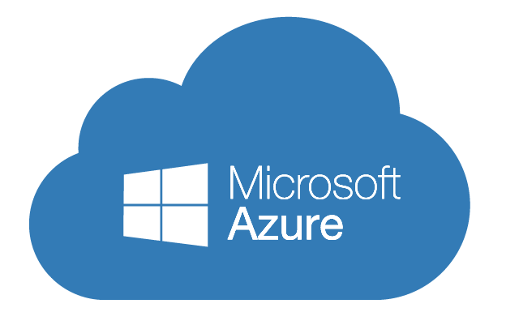

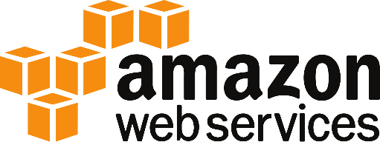
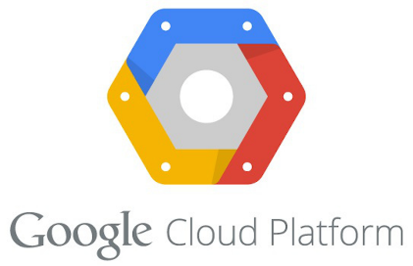

innovation vs. operations

Slide 11
is public cloud always possible?
legal contraints (compliance)
latency
bandwidth – connectivity at the country side
no cost savings - „Eh Da“ – already there
the CEO says so

Slide 12
real world constraints!
awareness of people – no willing
too old applications – latency / fat clients
shared SQL/Oracle Database with cross database joins
the network team says no
the organisation is not yet ready
cost savings gone

Slide 13
what about a hyper scaler technology in your OWN datacenter?

Slide 14
properties of a hyper scaler
no access to the underlaying technology (hypervisor)
hardware appliance - no access - closed box
the portal as your primay interface
transparent usage data for internal cost management
a well known API for automation
continuosly new services from the vendor (PaaS)

Slide 15
Microsoft Azure Stack powerd by HPE managed by ACP

Slide 16
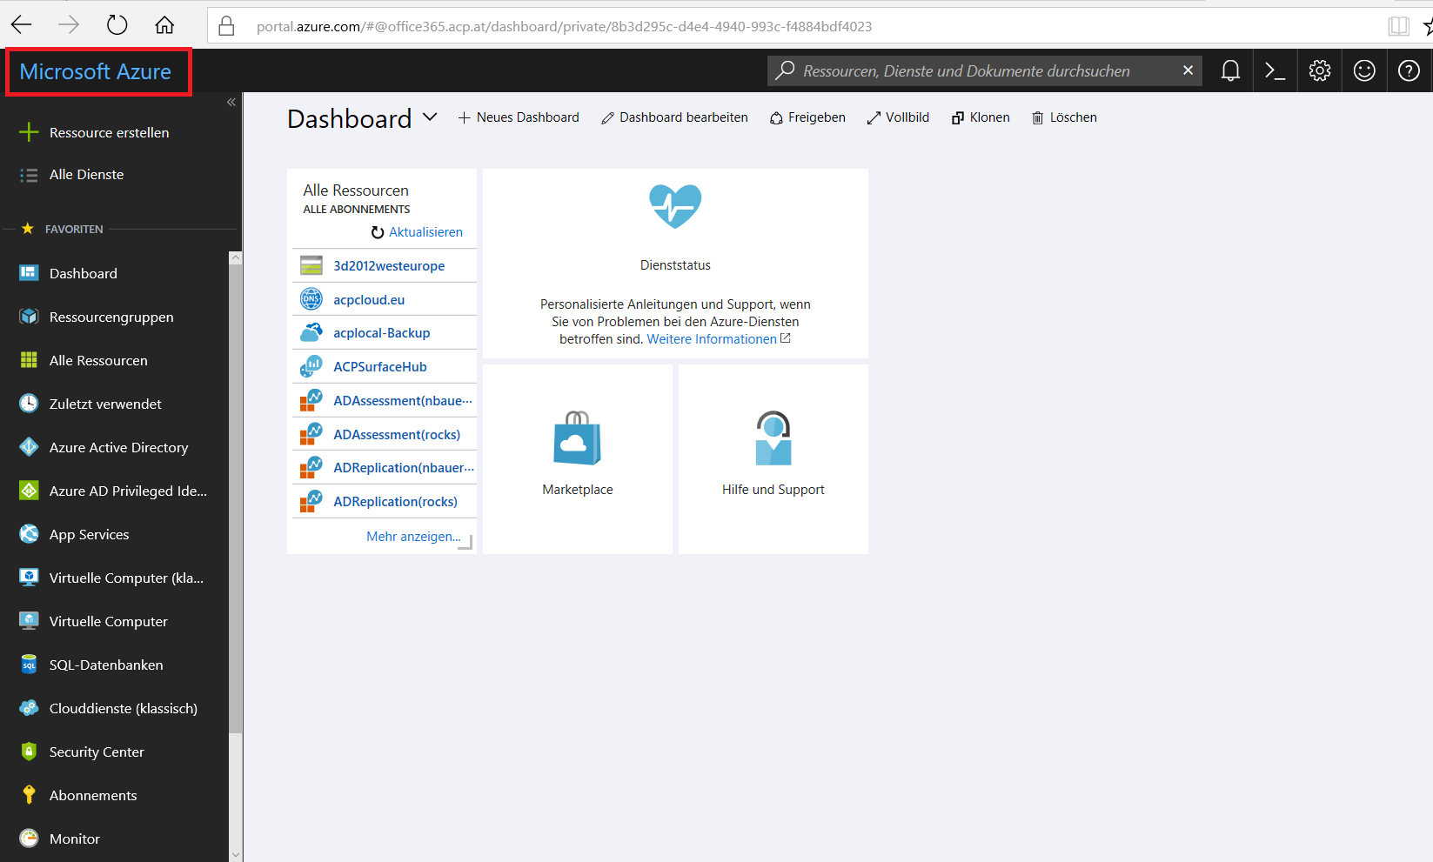

Slide 17
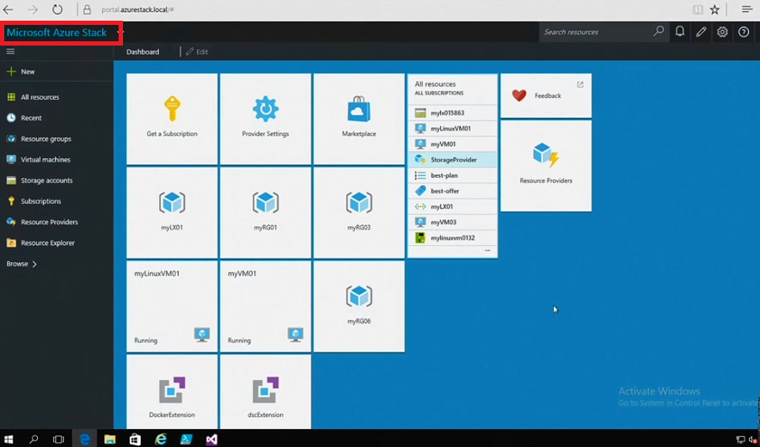

Slide 18
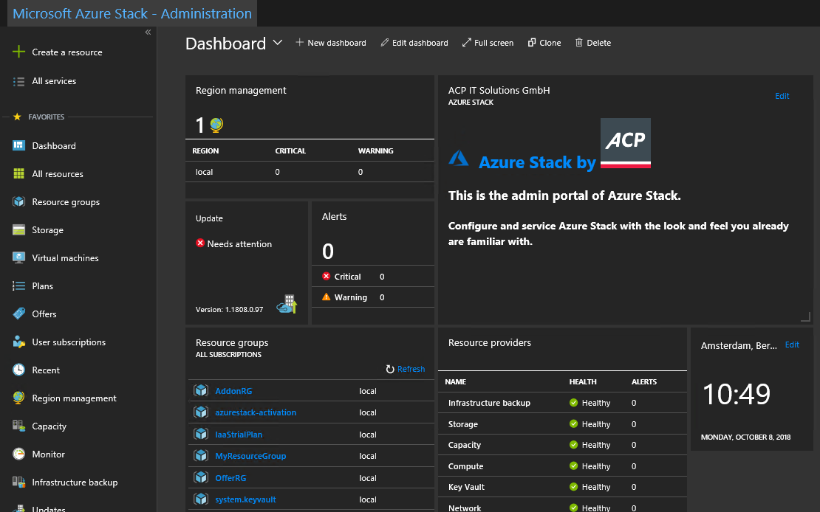

Slide 19
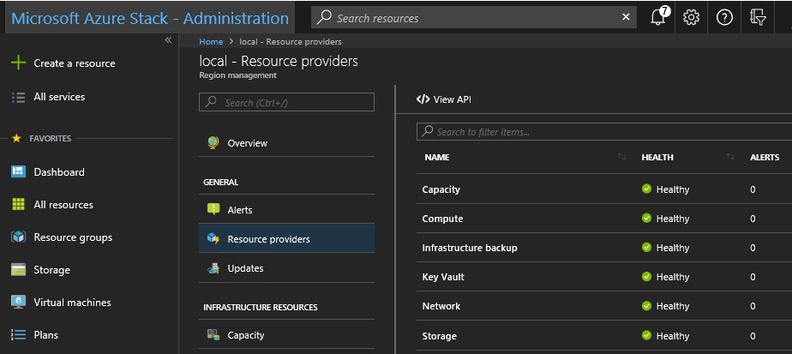

Slide 20
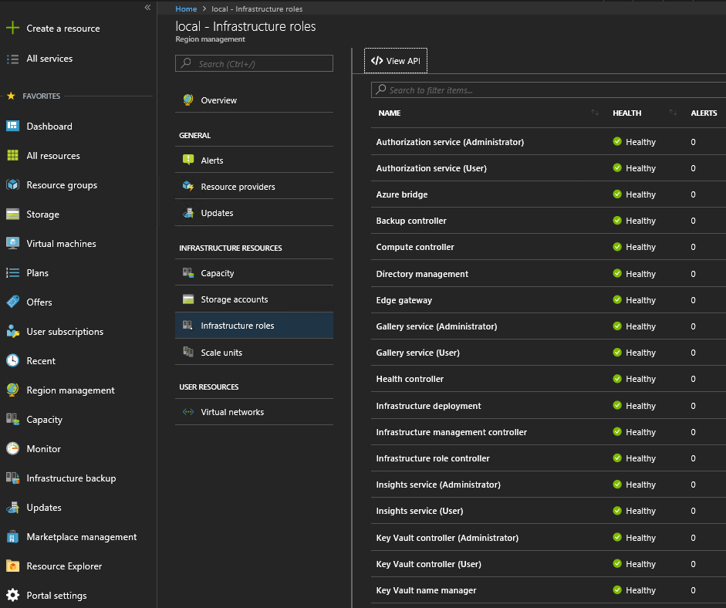

Slide 22

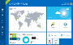
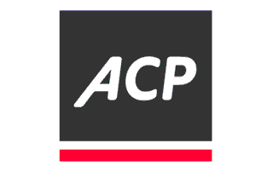
The Azure Hybrid Cloud Challenge
The operational challenge to consistently manage Hybrid Cloud
Developers
Portal
Portal
Today an organization moving to hybrid has differing levels of responsibilities depending on the platform
With Azure public, Microsoft handles everything but the application
With Azure Stack, the enterprise is expected to handle everything
Effective hybrid cloud needs a consistent operations experience as well as a consistent API and portal experience
On-Premises
Public
Consistent
API
API
Applications
Managed by
HPE & Partners
Applications
IaaS, PaaS, SaaS services
IaaS, PaaS, SaaS services
Cloud Software Platform
Cloud Software Platform
Hardware
Hardware
Datacenter
Managed by Microsoft
Datacenter

Slide 23
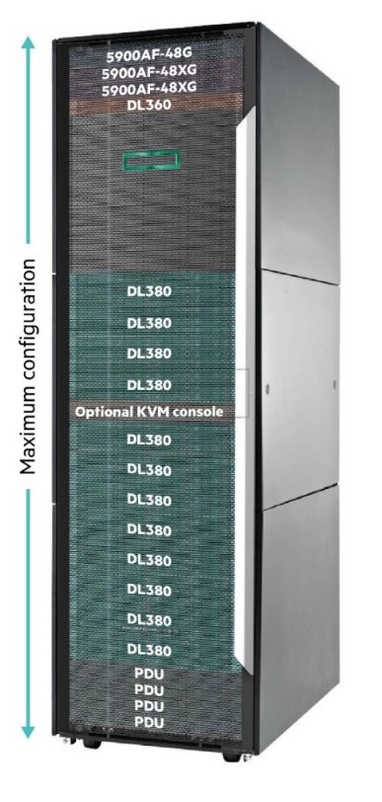

HPE Proliant & HPE Services for Microsoft Azure Stack
Fully integrated Azure Stack Solution built on the worlds most popular server - ProLiant DL 380
Factory Integration and onsite installation
Integrated system management simplifies operations HPE OneView
Multiple configuration options Processors, mem, storage, nodes, rack and network switches
Multiple packaging options
Factory integration or virtual rack
Flex Capacity
Azure Stack Managed Service Integration including:
Comprehensive solution design and azure integration
Provides Azure like experience for Azure Stack
Provide comprehensive run services for Azure Stack including Azure PaaS services
Single source for support for lifecycle of solution
Detailed azure stack consumption and billing portal
Network and Identity Integration
Hardware and Azure Stack monitoring and updates
Marketplace Syndication and Capacity Management
Optional Azure Applications Monitoring and Management
HPE HARDWARE
Pointnext Services

Slide 24
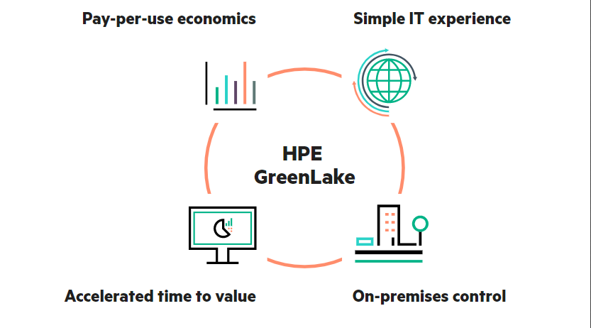
HPE GreenLake

Slide 25

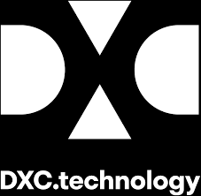

Creating industry leaders

Slide 26



The world will be hybrid
The Intelligent Edge will unleash an industrial IoT revolution
Services will be even more critical

Slide 27
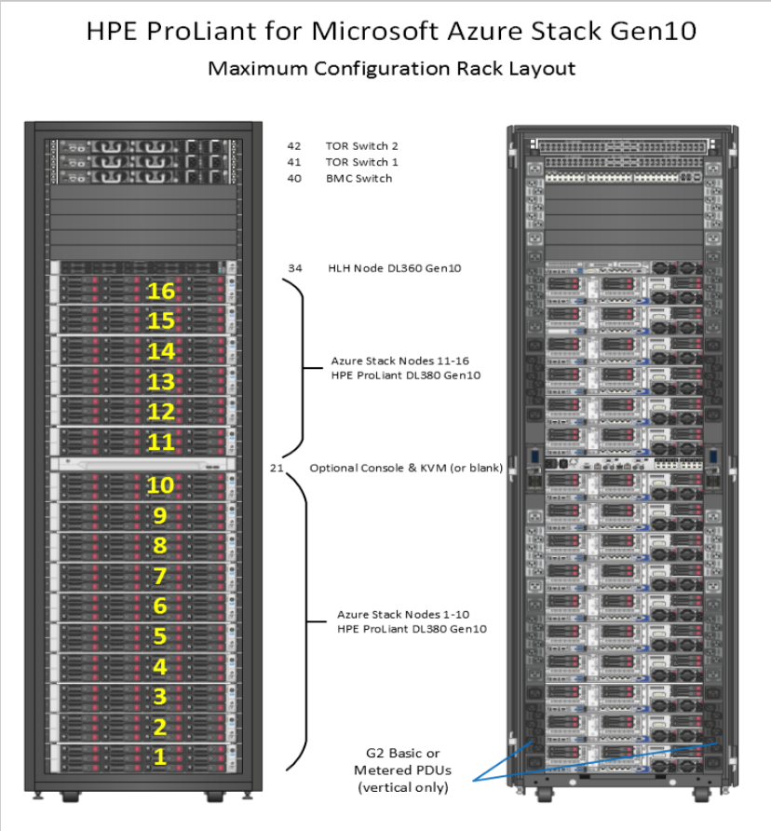
HPE ProLiant for Microsoft Azure Stack Solution (Gen10)
An On-Premise instance of Azure Stack and Portal to Azure Cloud

Slide 28
Microsoft Azure Stack on HPE ProLiant
Current
Next
Key Features
Hybrid MS Azure Stack HPE Gen 9 portfolio (4-12 nodes)
Gen 9 HLH
Support for HPE switches (TOR & BMC)
Support for Cisco switches (TOR & BMC)
Monthly PnU from Microsoft
HPE OneView support for lifecycle management tasks and monitoring
HPE Insight Remote Support for 24x7 real-time hardware event monitoring and Call-home features
HPE PointNext Services for consulting, FlexCapacity and Greenlake
Key Features
Support for Gen10 MS Azure Stack compute nodes with Gen9 HLH
Support for add node to Gen9 scale unit up to max of 12 nodes
Support for add node to Gen10 scale unit up to max of 16 nodes
Support for 25Gbe network
Network and Infra validation and support tool
Notes: This is a rolling (up to three-year) Roadmap and is subject to change without notice.
© Copyright 2017 Hewlett Packard Enterprise. The information contained herein is subject to change without notice. Hewlett Packard Enterprise Confidential

Slide 29
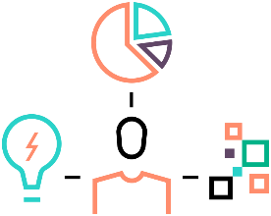





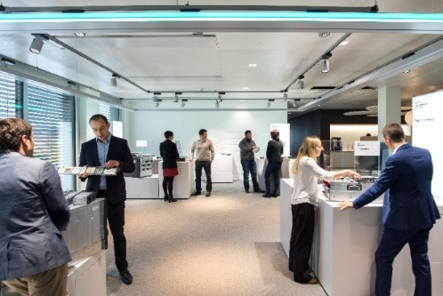
HPE Microsoft Azure Stack Innovation Centers
Bring your customers to meet HPE and Microsoft experts
Accelerate business and technical planning
Implement a Proof-of-Concept
Access the latest Microsoft Azure Stack software and HPE hardware
Meet with experts
Locations:
HPE Solution Center in Geneva, Switzerland
Remote access, Mobile units
Business planning workshop
Proof of Concept
Multi-node testing
Hackathon solution dev
Azure Stack Deployments
OEM Integrated Systems
Schedule an appointment, today!

Slide 30
wanna see?
DEMO

Slide 31
ACP workshop offering
design thinking workshops
cloud readiness
real cloud strategy
Microsoft Azure Stack JumpStart
proof of concept with your apps – real world workloads

Slide 32
key take away
Microsoft Azure Stack a true hybrid cloud solution
HPE & ACP parnering together for best delivery
reduces running cost with managed services by ACP
more money left for your innovation ;)

Slide 33
your contact @ booth
Cyrill Eigensatz
eigensatz@hpe.com
+41 79 401 01 36
Stefan Denninger
stefan.denninger@acp.at
+43 664 60187 11700
next Azure Stack Session: 1:30pm CLUB H, Thomas Maurer

